Slide 1
CSCI 104 Log Structured Merge Trees
Mark Redekopp
Aaron Cote’

Slide 2
Merge Trees Overview
Consider a list of (pointers to) arrays with the following constraints
Each array is sorted though no ordering constraints exist between arrays
The array at list index k is of exactly size 2^{k} or empty
An array at list location k can be of size 2^{k} or empty
0
1
2
3
4
…
NULL
…
5
2
0
3
4
1
…
6
9
Size = 8
12
Size = 16 if non-empty
14
18
20
51
Note: These are the keys for a set (or key,value pairs for a map)

Slide 3
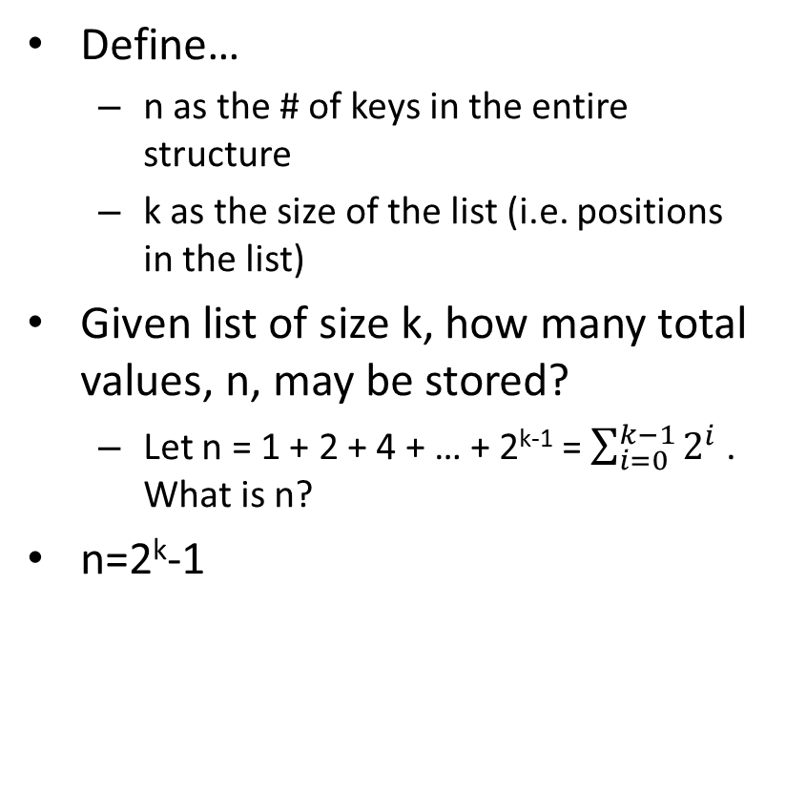
Merge Trees Size
Define…
n as the # of keys in the entire structure
k as the size of the list (i.e. positions in the list)
Given list of size k, how many total values, n, may be stored?
Let n = 1 + 2 + 4 + … + 2^{k-1} = $\sum_{i=0}^{k−1}{2^{i}}$ . What is n?
n=2^{k}-1
An array at list location k can be of size 2^{k} or empty
0
1
2
3
4
…
NULL
…
5
2
0
3
4
1
…
6
9
Size = 8
12
Size = 16 if non-empty
14
18
20
51
Note: These are the keys for a set (or key,value pairs for a map)

Slide 4
Merge Trees Find Operation
To find an element (or check if it exists)
Iterate through the arrays in order (i.e. start with array at list position 0, then the array at list position 1, etc.)
In each array perform a binary search
If you reach the end of the list of arrays without finding the value it does not exist in the set/map
An array at list location k can be of size 2^{k} or empty
0
1
2
3
4
…
NULL
…
5
2
0
3
4
1
…
6
9
Size = 8
12
Size = 16 if non-empty
14
18
20
51
Note: These are the keys for a set (or key,value pairs for a map)

Slide 5
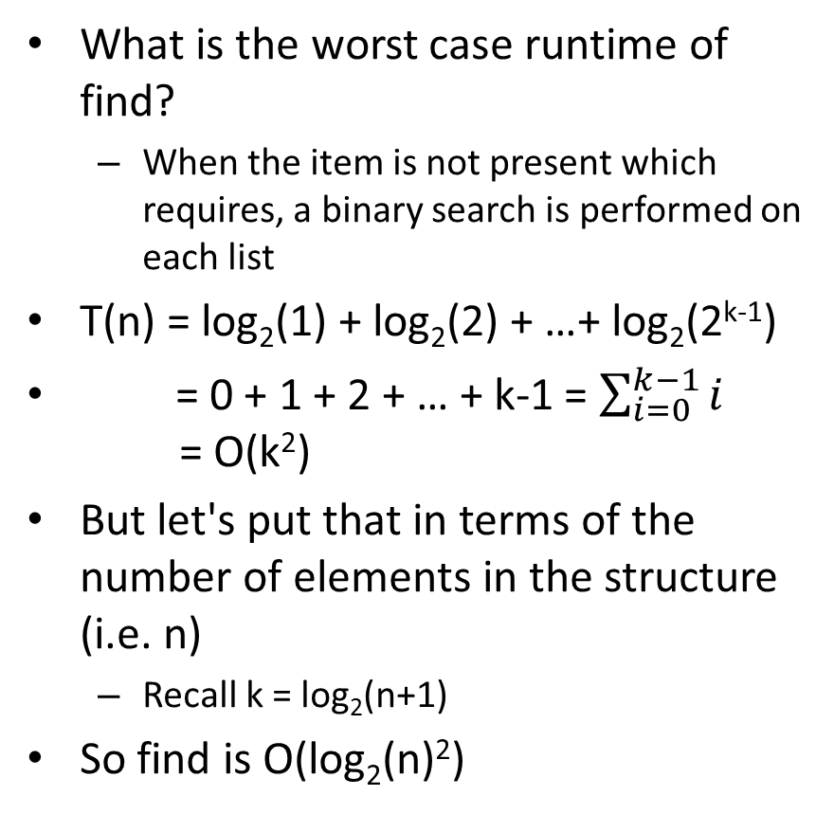
Find Runtime
What is the worst case runtime of find?
When the item is not present which requires, a binary search is performed on each list
T(n) = log₂(1) + log₂(2) + …+ log₂(2^{k-1})
= 0 + 1 + 2 + … + k-1 = $\sum_{i=0}^{k−1}{i}$ = O(k²)
But let's put that in terms of the number of elements in the structure (i.e. n)
Recall k = log₂(n+1)
So find is O(log₂(n)²)
An array at list location k can be of size 2^{k} or empty
0
1
2
3
4
…
NULL
…
5
2
0
3
4
1
…
6
9
Size = 8
12
Size = 16 if non-empty
14
18
20
51
Note: These are the keys for a set (or key,value pairs for a map)

Slide 6
Improving Find's Runtime
While we might be okay with [log(n)]², how might we improve the find runtime in the general case?
Hint: I would be willing to pay O(1) to know if a key is not in a particular array without having to perform find
A Bloom filter could be maintained alongside each array and allow us to skip performing a binary search in an array

Slide 7
Insertion Algorithm
An array at list location k can be of size 2^{k} or empty
Let j be the smallest integer such that array j is empty (first empty slot in the list of arrays)
An insertion will cause
Location j's array to become filled
Locations 0 through j-1 to become empty
insert(19)
j=2
0
1
2
3
…
NULL
…
5
2
0
4
1
6
9
Size = 8
12
Before insertion
14
18
20
0
1
2
3
…
…
…
…
2
0
4
1
5
6
19
9
After insertion
Size = 8
12
14
18
20

Slide 8
Insertion Algorithm
Starting at array 0, iteratively merge the previously merged array with the next, stopping when an empty location is encountered
insert(19)
0
1
2
0
1
2
0
1
2
3
…
NULL
NULL
…
…
NULL
…
19
5
2
2
2
0
4
5
4
4
1
Merge
19
5
6
19
9
Merge
Size = 8
12
List 0 is full so merge two arrays of size 1
14
List 1 is full so merge two arrays of size 2
18
20

Slide 9
Insert Examples
0
1
2
0
1
2
insert(4)
…
…
NULL
insert(8)
…
…
NULL
Cost = 1 / Stop @ 0
4
Cost = 1 / Stop @ 0
8
2
4
0
1
2
5
insert(2)
…
…
NULL
19
Cost = 3 / Stop @ 1
2
0
1
2
4
insert(7)
…
…
NULL
0
1
2
Cost = 1 / Stop @ 1
7
2
insert(5)
…
…
NULL
8
4
Cost = 1 /
Stop @ 0
5
2
5
4
19
0
1
2
0
1
2
insert(19)
insert(12)
…
…
NULL
…
…
NULL
Cost = 7 /
Stop @ 2
Cost = 1 /
Stop @ 0
12
7
2
2
4
8
4
5
5
19
19

Slide 10
Insertion Runtime: First Look
0
1
2
Best case?
First list is empty and allows direct insertion in O(1)
Worst case?
All list entries (arrays) are full so we have to merge at each location
In this case we will end with an array of size n=2^{k} in position k
Also recall merging two sorted arrays of size m/2 is Θ(m)
So the total cost of all the merges is 1 + 2 + 4 + 8 + … + 2^{k} = Θ(2^{k+1}) = Θ(n)
But if the worst case occurs how soon can it occur again?
It seems the costs vary from one insert to the next
This is a good place to use amortized analysis
insert(4)
…
…
NULL
4
0
1
2
insert(2)
…
…
NULL
2
4
0
1
2
insert(5)
…
…
NULL
5
2
4
0
1
2
insert(19)
…
…
NULL
2
4
5
19

Slide 11
Total Cost for N insertions
Reminder: Insert stopping at location k requires 1+2+4+…+2^{k-1}+2^{k} = 2^{k+1}-1 = O(2^{k+1}) merge steps
Total cost of n=16 insertions:
Stop at: 0,1,0,2,0,1,0,3,0,1,0,2,0,1,0,4
Cost: 2¹+2²+2¹+2³+2¹+2²+2¹+2⁴+2¹+2²+2¹+2³+2¹+2²+2¹+2⁵
=2¹*n/2 + 2²*n/4 + 2³*n/8 + 2⁴*n/16 + 2⁵*1
= n + n + n + n + 2*n
=n*log₂(n) + 2n
Amortized cost = Total cost / n operations
log₂(n) + 2 = O(log₂(n))

Slide 12
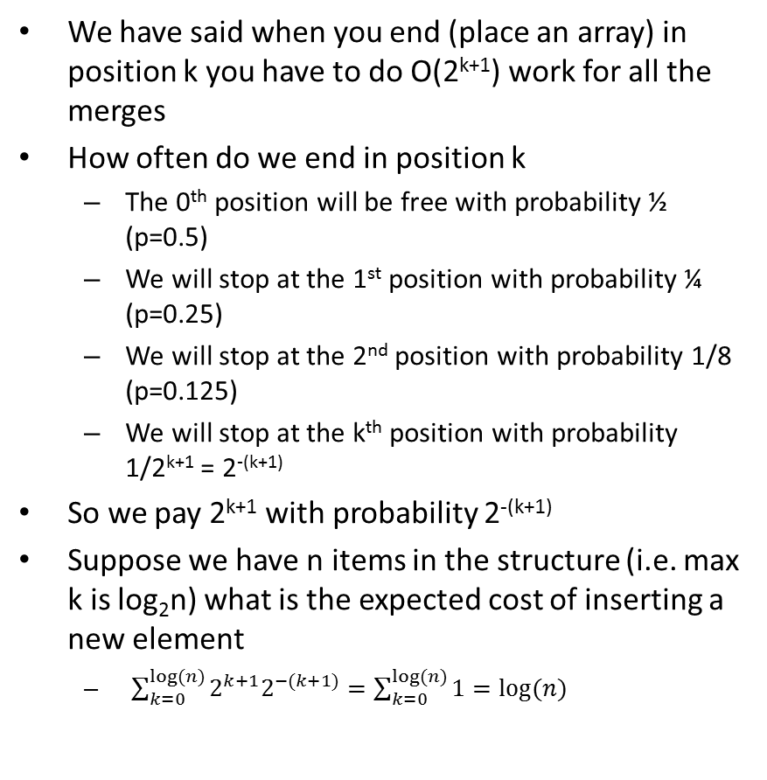
Amortized Analysis of Insert
0
1
2
We have said when you end (place an array) in position k you have to do O(2^{k+1}) work for all the merges
How often do we end in position k
The 0th position will be free with probability ½ (p=0.5)
We will stop at the 1st position with probability ¼ (p=0.25)
We will stop at the 2nd position with probability 1/8 (p=0.125)
We will stop at the k^{th} position with probability 1/2^{k+1} = 2^{-(k+1)}
So we pay 2^{k+1} with probability 2^{-(k+1)}
Suppose we have n items in the structure (i.e. max k is log₂n) what is the expected cost of inserting a new element
$\sum_{k=0}^{log⁡(n)}{2^{k+1}2^{−(k+1)}}=\sum_{k=0}^{log⁡(n)}{1}=log⁡(n)$
insert(4)
…
…
NULL
Cost = 1 / Stop @ 0
4
0
1
2
insert(2)
…
…
NULL
Cost = 2 / Stop @ 1
2
4
0
1
2
insert(5)
…
…
NULL
Cost = 1 /
Stop @ 0
5
2
4
0
1
2
insert(19)
…
…
NULL
Cost = 4 /
Stop @ 2
2
4
5
19

Slide 13
Summary
Variants of log structured merge trees have found popular usage in industry
Starting array size might be fairly large (size of memory of a single server)
Large arrays (from merging) are stored on disk
Pros:
Ease of implementation
Sequential access of arrays helps lower its constant factors
Operations:
Find = log²(n)
Insert = Amortized log(n)
Remove = often not considered/supported
More reading:
http://www.benstopford.com/2015/02/14/log-structured-merge-trees/

